Slide 1

Java V/s C++
By >> Tyler Zenisek

Slide 2
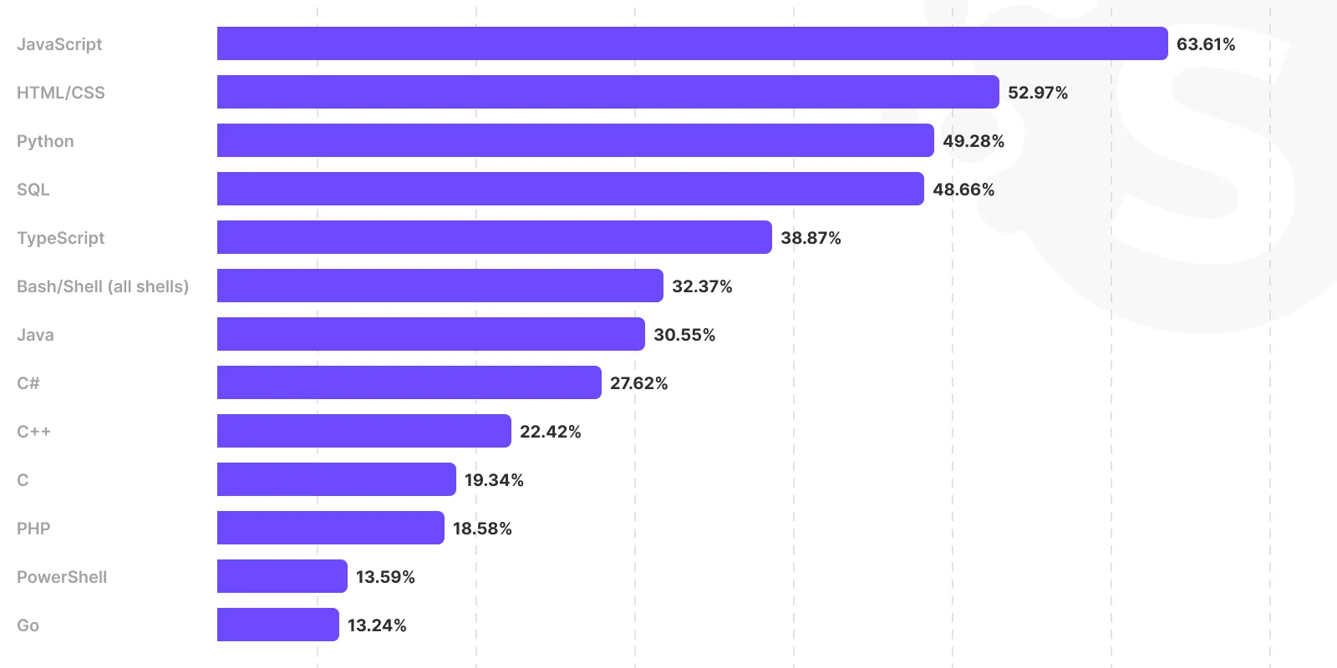
Why Java and C++?

Slide 3
Some similarities
Both are considered higher level programming languages
Both are capable of data manipulation, GUI programming, servers/networking tasks, and database storage
Both offer a large collection of built in libraries and documentation
Both are popular languages today though Java is considerably more popular
Both are OOP languages and compiled languages

Slide 4
C++
C++ operates closely with the hardware on a system
C++ offers fast program execution with slower loading times
C++is a strict language
C++ is well known making it fairly portable across systems
C++ has its own unique compiler
**C++ is difficult for new programmers to learn and difficult to read

Slide 5
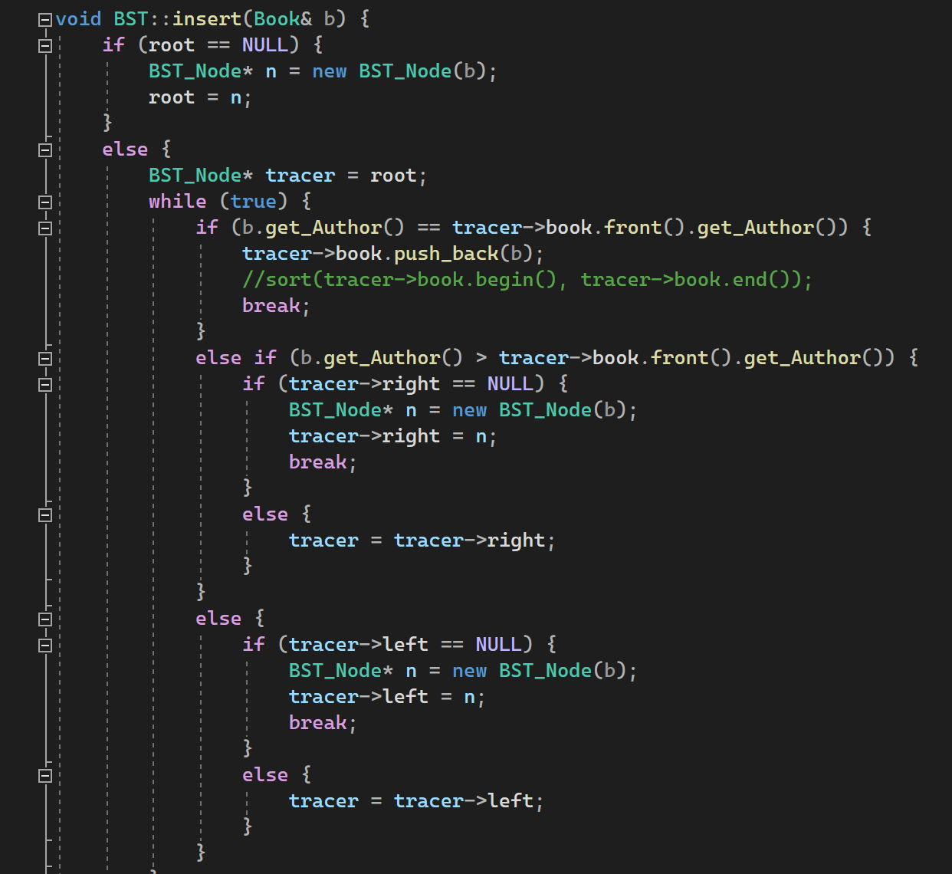

Slide 6
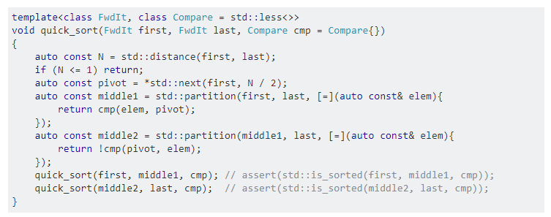

Slide 7
C++ Compiler
1st- Source program takes file in txt form and transforms them into Object Files
- The processing stage where the compiler processes statements in the code such as if, ifdef, include, and programa statements
- Next the C++ code is split into tokenization
- Finally the tokens are parsed into a Concrete Syntax Tree, and further parsed from there to an Abstract Syntax Tree which is used to generate the Object Files
2nd- The C++ linker takes the resulted Object Files and uses them to create a single binary file.
- The linker specifically uses the Object Files produced via the Translation Units in the beginning of compilation
3rd- The Single binary file is executed on a hardware level to run the program

Slide 8
How does java compare?
Java exists as an easier and more portable C++
Java is significantly easier to learn to program
Java has a different compiler known as the JVM (Java Virtual Machine) which is more portable
Java simplifies the typing of variables and data manipulation by automating copying and address reallocation
Java is far more Object Orientated than C++ is in the sense that everything is a class
Java offers several more features than C++ making it a more popular and flexible language such as class reflection, and code injection

Slide 9
Java Disadvantages
Java is a heavy language that requires a large amount of storage to run due to the JVM
Java in design with large projects leads to very complex and messy code that can overtake that of C++
Java lacks the manual features of C++ that enable a user to handle addressing themselves
Java now does require a commercial license to deploy and use many of its higher end features

Slide 10
The JVM(Java Virtual Machine)
In the name, the JVM is a virtual machine that can be ran on most any system enabling java code or any language that uses the java encoder (such as Kotlin) to run programs.
Thus the JVM is more than just a compiler but also a program loader.
The JVM uses memory in a specific way
- Method Area: This is a shared resource across the JVM used for class names, function names, variables etc
- Heap Area where all objects are stored
- Stack area where all threads are stored
- PC Registers: This is for addressing

Slide 11
The JVM continued…
The execution Engine is the compiler for the JVM.
The interpreter is first which is essentially what the C++ compilers processor or Tokenizer is
Then the JIT (Just-In-Time Compiler) uses the object byte code the interpreter provided to run the program
During program run time the Garbage Collector allocates and deallocates memory as needed to improve efficiency

Slide 12

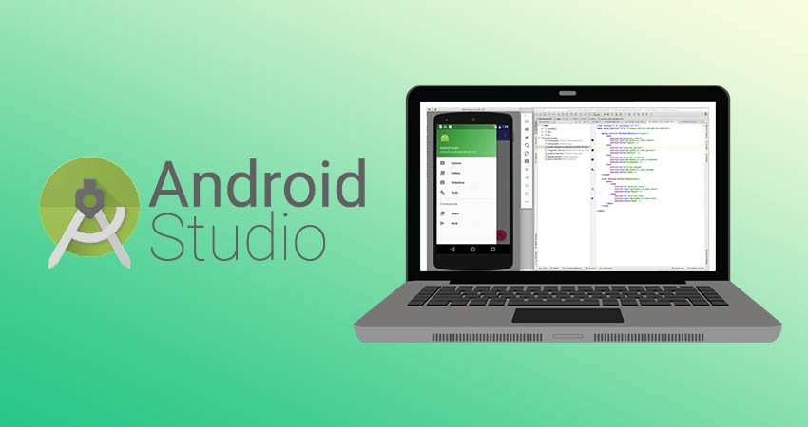
Java Support
Spring Boot
Servers
Web Development
Web Hosting
Microservices
Android Development with Android Studio
- Android App Development front to mid end

